Slide 1
KNN (K-nearest neighbors) Classification Algorithm

Slide 2
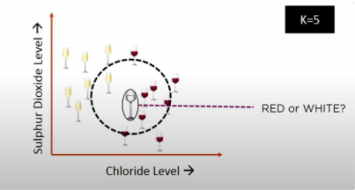
Intuition
K- nearest algorithm, often abbreviated as KNN, is an approach to data classiﬁcation that estimates how likely a data point is to be a member of one group or another depending on what group the data points nearest to it are in.
K in KNN refers to the number of nearest neighbour to include in the majority voting process.

Slide 3
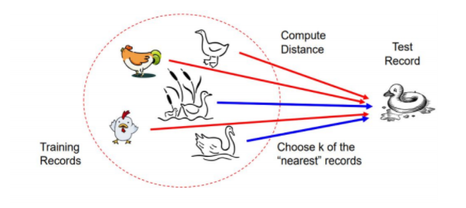
CLASSIFICATION APPROACH
➤ An object (a new instance) is classified by a majority votes for its neighbour classes.
➤ The object is assigned to the most common class amongst its K nearest neighbours (measured by a distance function)

Slide 4

HOW DOES KNN ALGORITHM WORK?
Step-1: Select the number K of the neighbors
Step-2: Calculate the Euclidean distance of K number of neighbors
Step-3: Take the K nearest neighbors as per the calculated Euclidean distance.
Step-4: Among these K neighbors, count the number of the data points in each category.
Step-5: Assign the new data points to that category for which the number of the neighbor is maximum.
Step-6: Our model is ready.
The euclidean distance between X and Y is defined as:

Slide 5
Through many observations it has been found that the most optimal value of “K” is found to be sqrt(N), N – number of data points

Slide 6
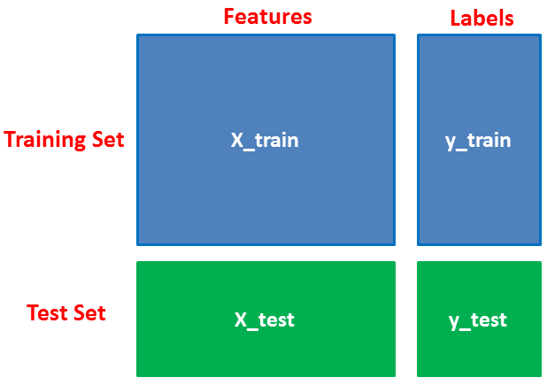
Training and testing data in a dataset
The data we use is usually split into training data and test data. The training set contains a known output and the model learns on this data in order to be generalized to other data later on.
We have the test dataset (or subset) in order to test our model’s prediction on this subset.

Slide 7
